Slide 1

Outland Adventures

Slide 2

Group 2 Team Members
Ryan Church
Darius Dinkins
Taylor Donlea
Tanner Glaser

Slide 3
Case Study Overview
Outland Adventures is a travel outfitter that offers hiking and camping expeditions to several locations around the world.
Each trip is coordinated by a guide who assists clients in planning the travel, as well as vetting visa and immunization requirements.
Each location will offer several trips throughout the year led by one of the guides
In addition to the expeditions, the company also offers rental and /or purchase of outdoors equipment and supplies

Slide 4
Organization Questions
Are there enough customer purchases to continue offering equipment sales?
Are there any inventory items near or over five years old?
Are any of the three trip destinations experiencing a net decrease in bookings?

Slide 5
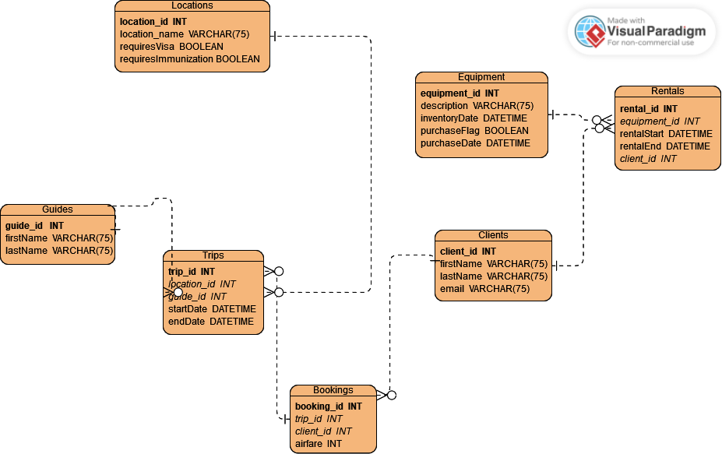
Final ERD Model

Slide 6
Table Details
Guides—list of guides available for a trip
Clients—personal info for clients who can book trips/rent equipment
Trips—instances of a trip to a given location
Bookings—list of clients associated with a given trip
Locations—potential travel destinations
Equipment—List of items available for rental or purchase, along with inventory date for when it came into inventory.
Rentals—Tracks client rentals of equipment

Slide 7
Purchases of Equipment
A query was ran computing the total # of items in inventory, versus those that had been purchased.
The percentage of inventory that has been purchased is roughly 13%.
As it’s not frequently used, Outland Adventures may wish to discontinue this capability.

Slide 8
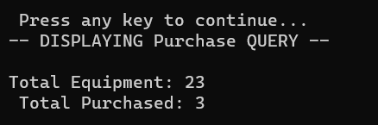
Aging of Equipment
Outland Adventures wanted to tell whether offering equipment sales was worthwhile
A query was created to capture the total items purchased, as well as total items in the inventory table
As volume of purchased items is roughly 13% of the total, Outland Adventures could get rid of this infrequently used benefit.

Slide 9

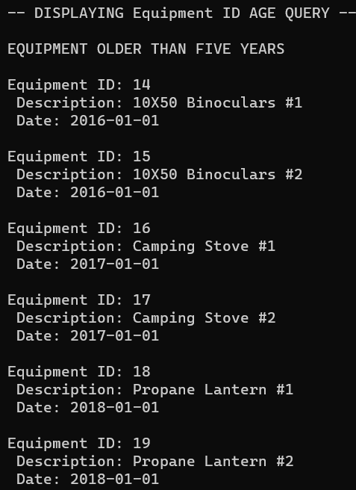
Aging of Equipment
An initial query was run to gauge if any inventory items were over 5 years old
From there, a more detailed query was ran to identify those items that might need inspection/replacement
As more than a quarter of their inventory is over the 5-year mark, it’s likely that some of the items need to be refreshed.

Slide 10
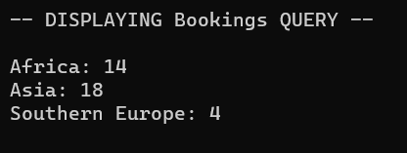
Popularity of Destinations
An initial query was run to gauge the total bookings by location
Trips to Southern Europe are the least popular offering in terms of overall bookings
Do we see any trend positive or negative in bookings? For that we’ll need another query

Slide 11
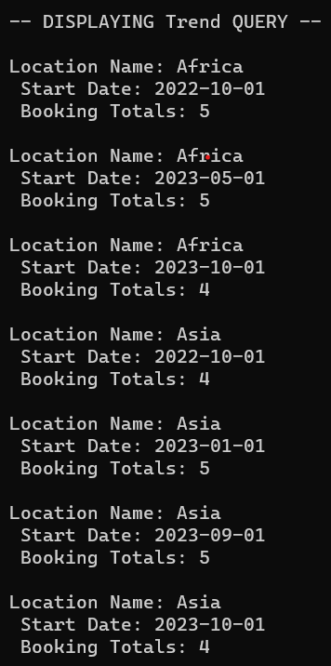
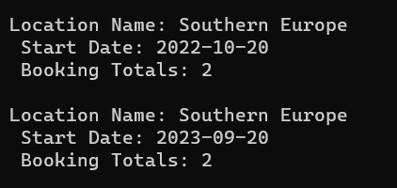
Popularity of Destinations Continued
Asia and Africa continue to have roughly the same # of clients for each outing
Trips to Southern Europe are consistently having the least particpants when a trip is offered.
Outland Adventures may benefit from discontinuing the Europe trips and focusing more on the African and Asian Exepditions

Slide 12
Activity Assumptions
One of the two guides will be tied to each trip
Assumed airfare costs are dependent on client’s location, so it was moved to the bookings table.
Having an inventory date for when the item was first available will aid in tracking age
A purchase flag/date makes it easy to track what has been purchased.
Assumed clients would book one or more trips

Slide 13

Thank You

